Slide 1
Sequencing
The most simple type of program uses sequencing, a set of instructions carried out one after another.
Start
Display “Computer”
Display “Science”
Display “Rocks”
End

Slide 2
Flowcharts
Flowcharts are used to plan programs before they are created.
 | The start or end of the program. There may be more than one way to complete the algorithm and there may be more than one end box.
 | A process, that is doing something for example calculating something.
 | An input or output, for example: Input num1
 | A decision, YES or NO, or a choice of paths, for example: Is it a weekday?
 | A subroutine or self-contained program that can be used as required.
 | When a flowchart will not fit onto a single page we use this shape to show how the sections of the flowchart connect together.

Slide 3
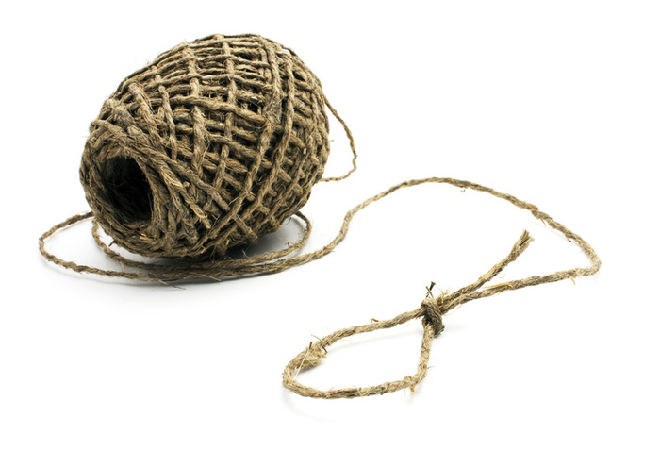
Strings
In programming we usually call normal text a string.
“What’s your name?”
A string is a collection of alphabetic and/or numeric characters.
We tell the computer something is a string by putting quote marks around it.

Slide 4



Sequencing
Match the Python code to the correct part of the flowchart.
Start
Display “Computer”
Display “Science”
Display “Rocks”
End

Slide 5
Python
Open the Python IDLE. Start a new program by clicking on File > New File.
Enter the code from the previous slide.
Save your program as sequencing.py and press F5 to run it.

